Slide 1
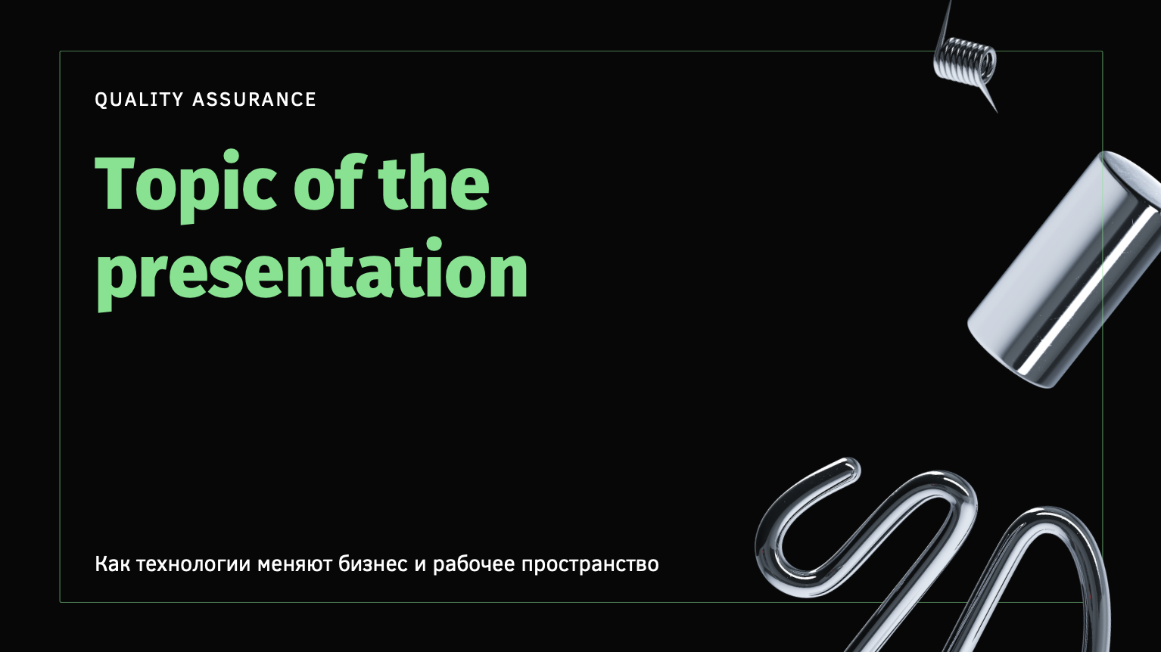
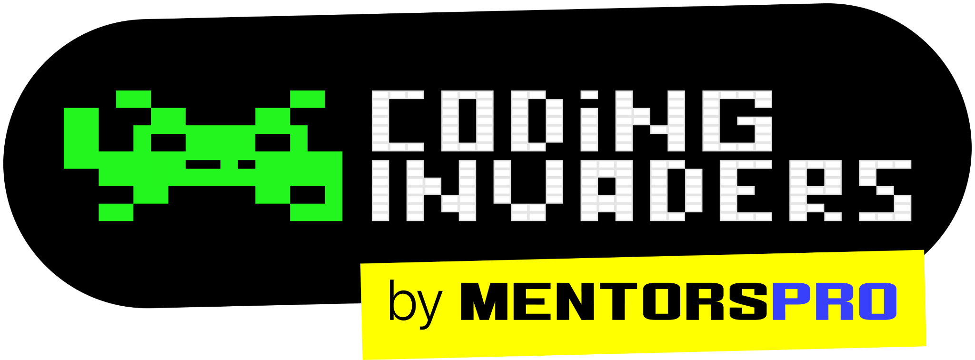
QA Automation Engineer
“Software Testing Introduction Session -3”
By: Manas
Content Title
Notes:
Title - Fira Sans, 50pt
Subtitle - Fira Sans, 16pt

Slide 2
Types of Testing
Smoke Testing
Sanity Testing
Installation Testing
Black box testing
White Box Testing
UAT Testing
Regression Testing
Defect Retesting
Performance Testing
Usability Testing

Slide 3
STLC (Software Testing Life Cycle) STLC is step by step process which are following to complete the testing activity in a project. There are 10 different phases in STLC 1. Test Initiation/Analysis 2. Test Plan 3. Identify the test scenario 4. Test case design 5. Test data preparation 6. Test case execution in testing environment 7. Defects 8. Defects Retesting 9. Regression Testing 10 Testing Closure

Slide 4
STLC (Software Testing Life Cycle) is also called as…
End to End process of Testing
Testing Life Cycle
Manual Testing Life Cycle

Slide 5
Test Scenario
Test Cases
Test Script
Test Data

Slide 6
Test Scenarios
A Test Scenario is any functionality that can be tested.
It is a collective set of test cases which helps the testing team to determine the positive and negative characteristics of the project.
Test Scenario gives a high-level idea of what we need to test.
“It is also called Test Condition or Test Possibility.”

Slide 7
Test Cases
It is a document that contains the steps that have to be executed.
A Test Case is a set of actions executed to verify a particular scenario or functionality of your software application. A Test Case contains test steps, test data, precondition, post condition developed for specific test scenario to verify any requirement.

Slide 8
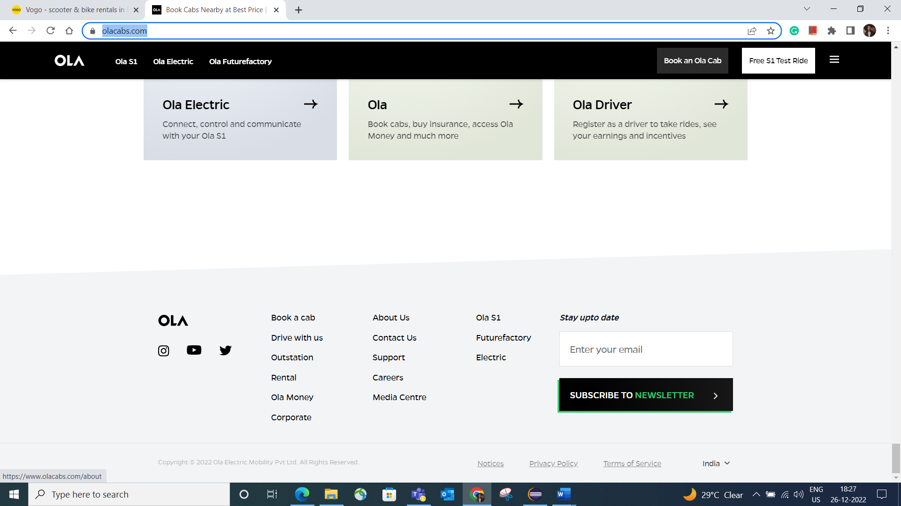
Verify that 'About Us' link should be displayed in footer and User should be able to click on 'About Us' link.
Sl No | Test Case | Expected Result | Test Data | Test Status
1 | Launch the Application as per the test data. | User should be able to launch the Application. | https://www.olacabs.com/ | Pass
2 | Go to footer of Application. | User should be able to go to the footer of Application and 'About Us' link should be displayed as per the attached mock-up |  | Pass
3 | Click on the 'About Us' link. | User should be able to click on 'About Us' link. |  | Pass

Slide 9
Test Scenario Test Cases
High Level Document
By looking into this it will hard to test the application
It tell us what to test
Test Scenario doesn’t have data that you need to enter to an application to test
Test Scenario is just a short sentence which says what to test
Test Scenarios are derived from the requirements
Need less time to prepare
Detailed Document
By looking into Test Cases you can easily test the application
It tell us how to test
Test Cases has all the exact data that you need to entered
Test Cases have steps to reproduce, precondition and post condition
Test Cases derived from the test scenario
Need more time to prepare

Slide 10
Test Script
It is written in programming language.
The test script is a set of instructions to test an application automatically.
Eg.. Automation Script

Slide 11
Test Case | Test Script
Test case is a step by step procedure that is used to test an application. | The test script is a set of instructions to test an application automatically.
Test Cases are used for manual testing environment. | Test Script is used in the automation testing environment.
It is done manually. | It is done according to the scripting format.
The test case template includes Test ID, test data, test procedure, actual and expected results, etc. | In the Test Script, we can use different commands to develop a script.

Slide 12
Test Data
A data or value which are using to perform testing on the application is called Test Data.

